Slide 1
“Done? Are you Sure”
a checklist-tracker tool I’ve found useful
Birkin James Diana / Brown University / Code4Lib-NE-2019
Notes:
intro

Slide 2
the things…
versioned?
public url?
mobile-friendly?
accessible?
has site-checker entry?

Slide 3
more things…
uses long-term-release version?
https enforced?
admin-links shib-protected?
logs auto-rotated?
P.I. Information policy implemented?

Slide 4
yet more things…
session-data auto-expired?
https enforced?
admin-links shib-protected?
emails admin on error?
(github) known vulnerabilities fixed?

Slide 5


Slide 6
a solution…
library.brown.edu/good_code
github: bul_cbp_project
features
why i think it works
for me

Slide 7
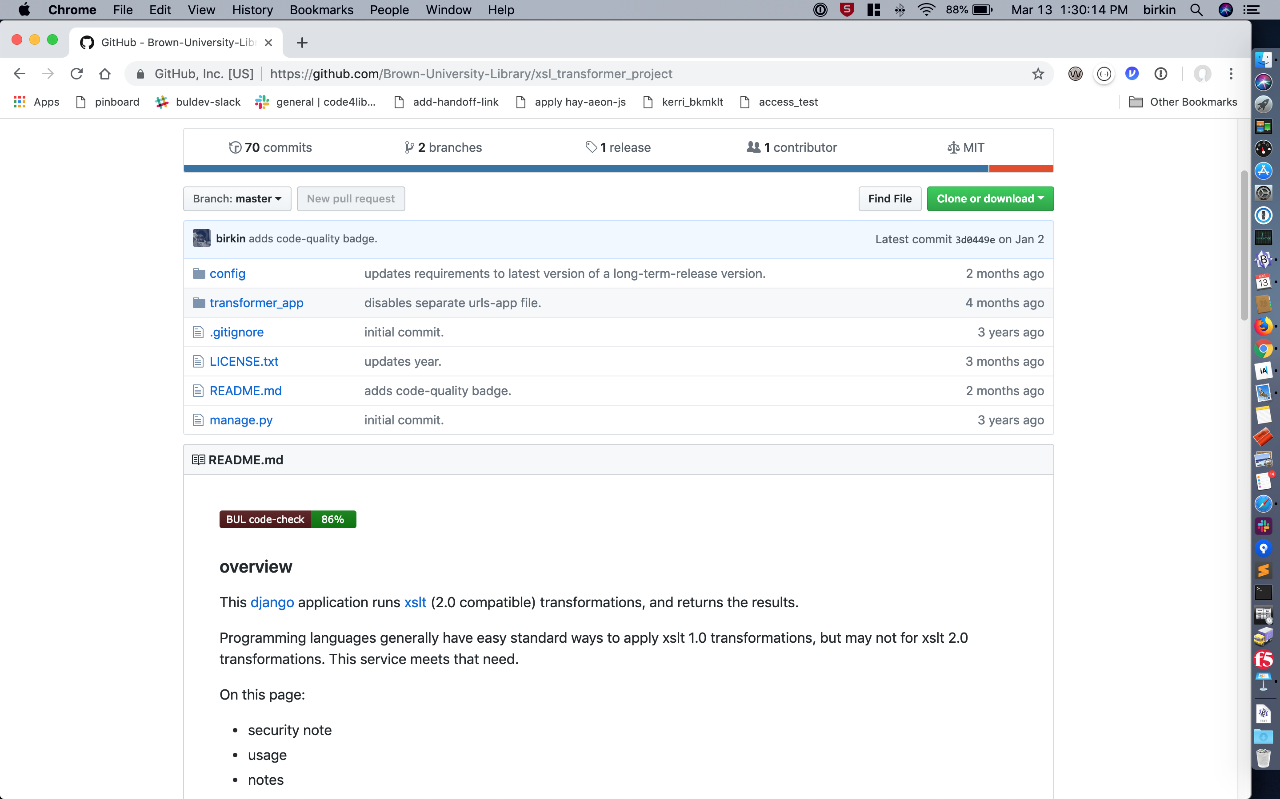
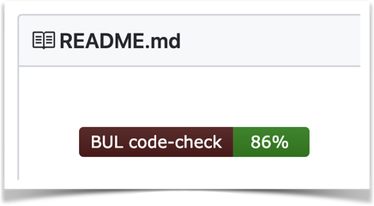
the “badge”

Slide 8
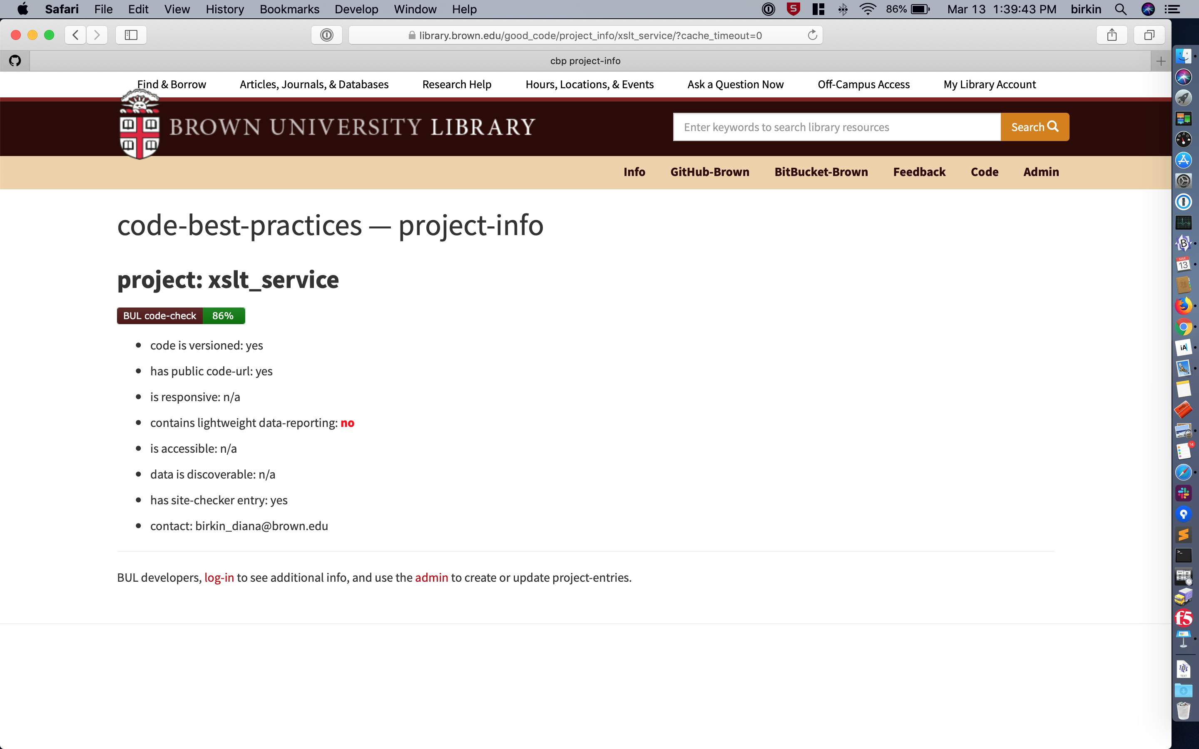
project’s public checklist-page

Slide 9
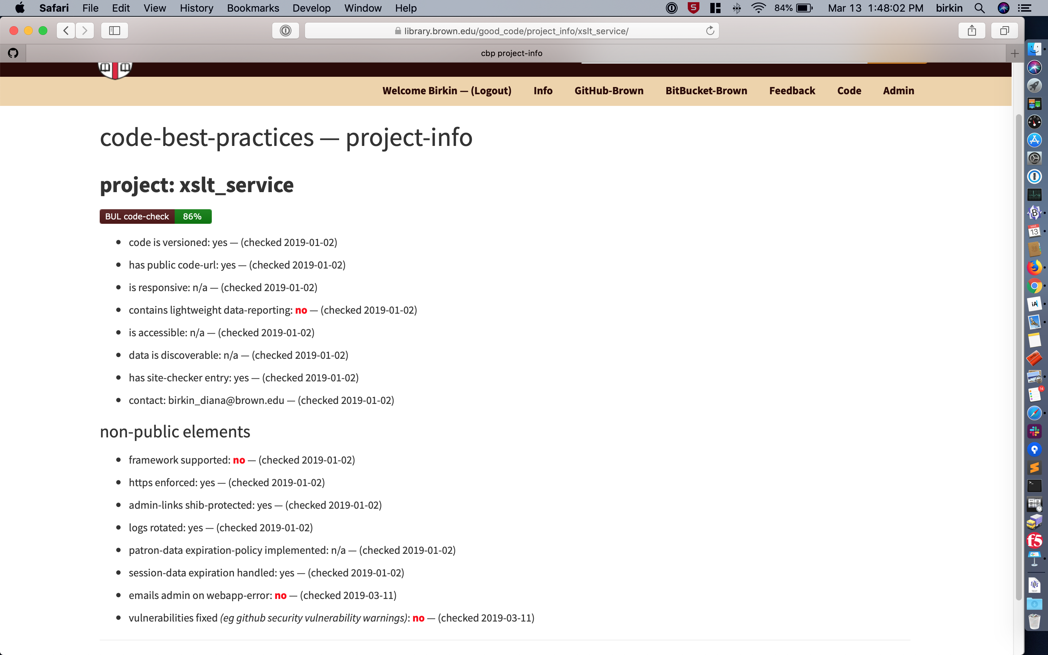
project’s logged-in checklist-page

Slide 10
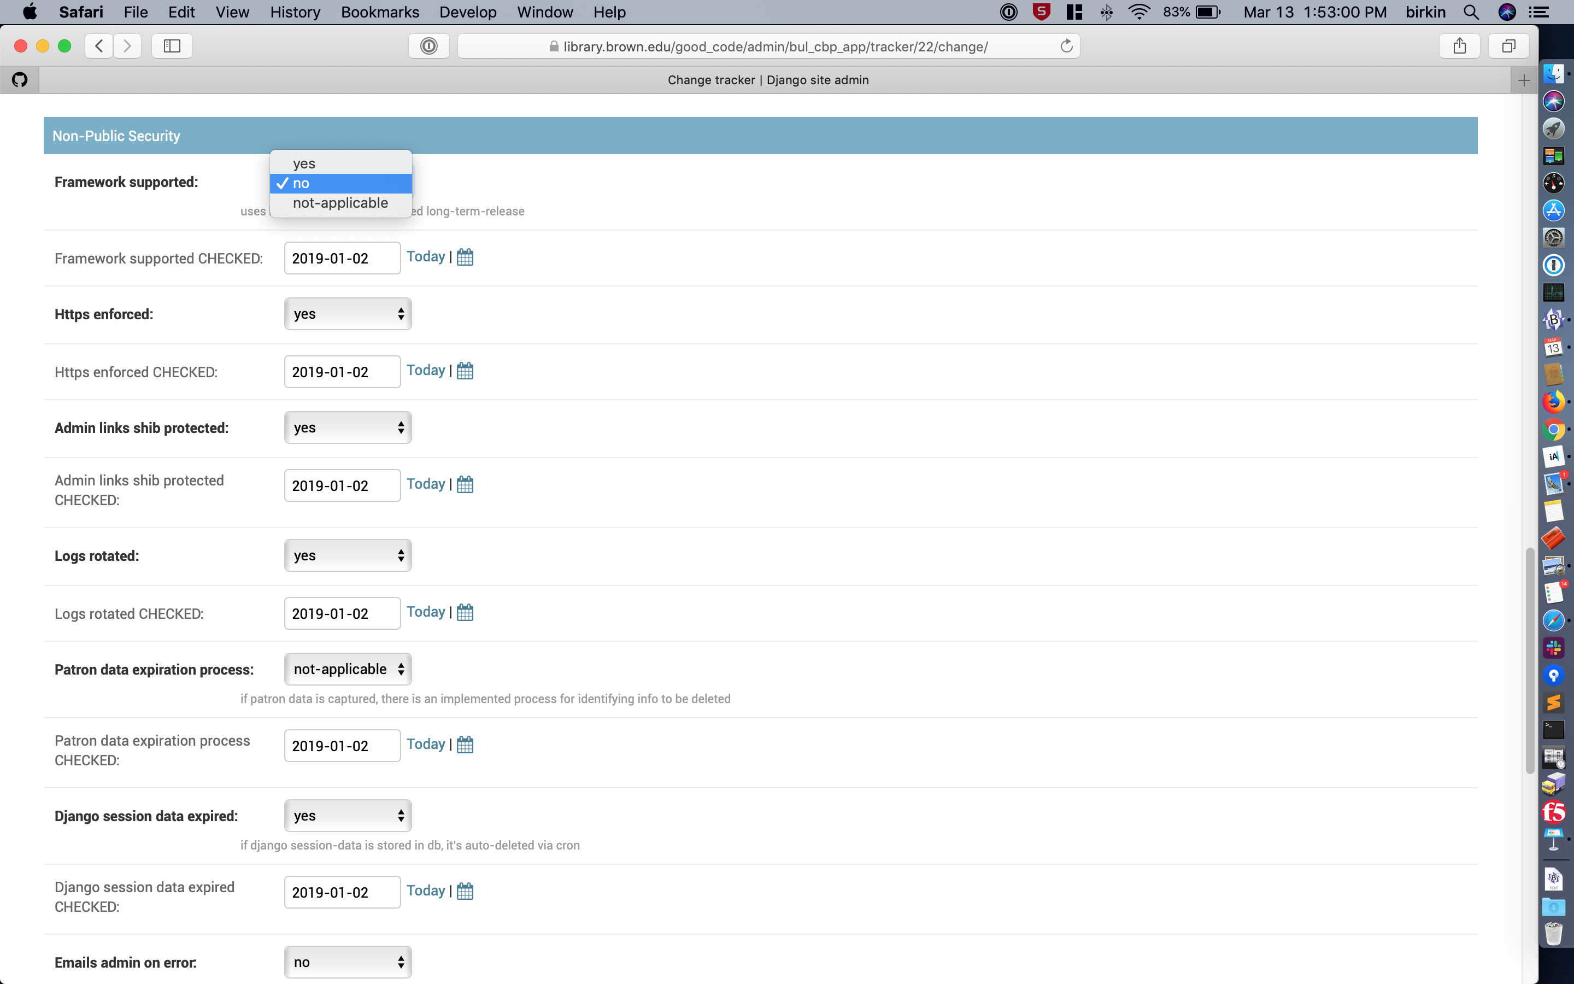
project’s admin page

Slide 11
new project?
library.brown.edu/good_code
log-in to Admin
click ‘New’
give it a name and your email-address
click ‘Save’

Slide 12
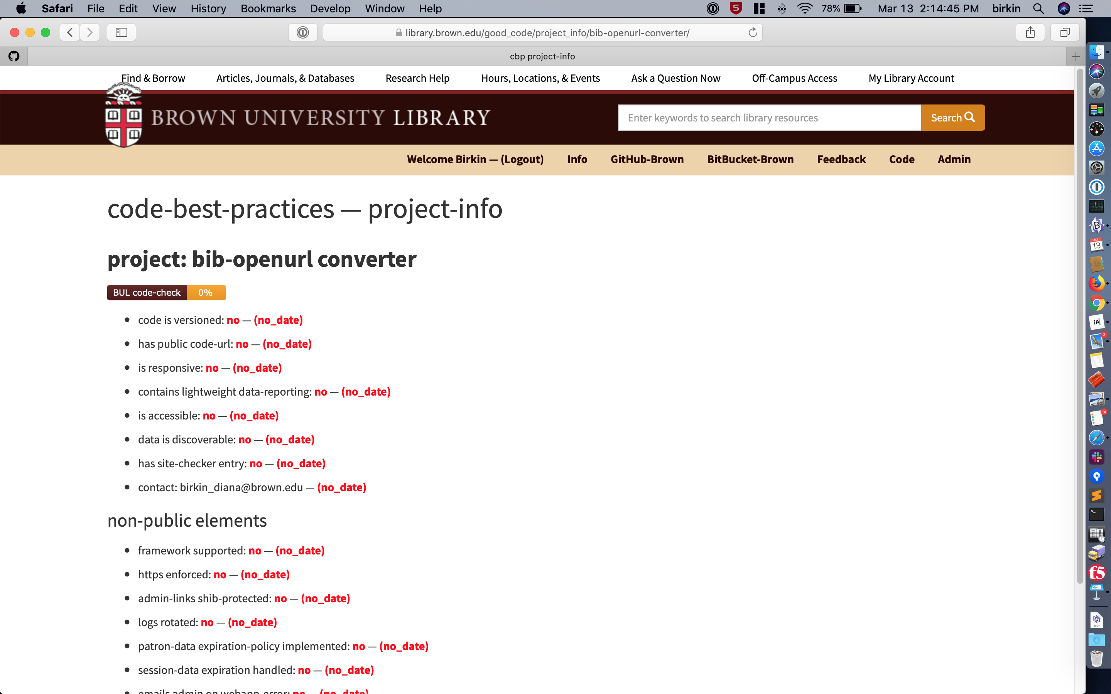
new-project: logged-in

Slide 13
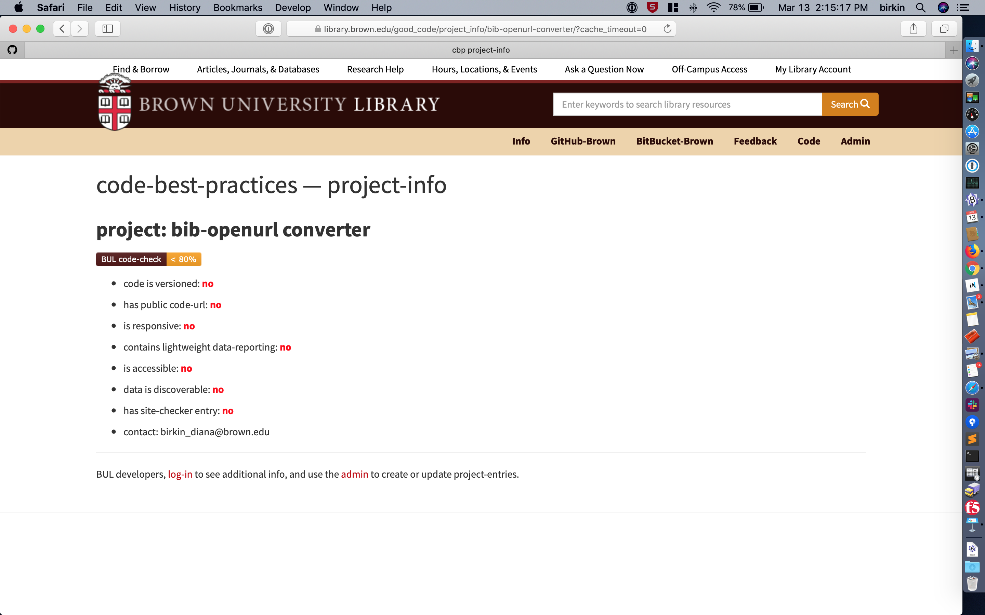
new-project: public

Slide 14
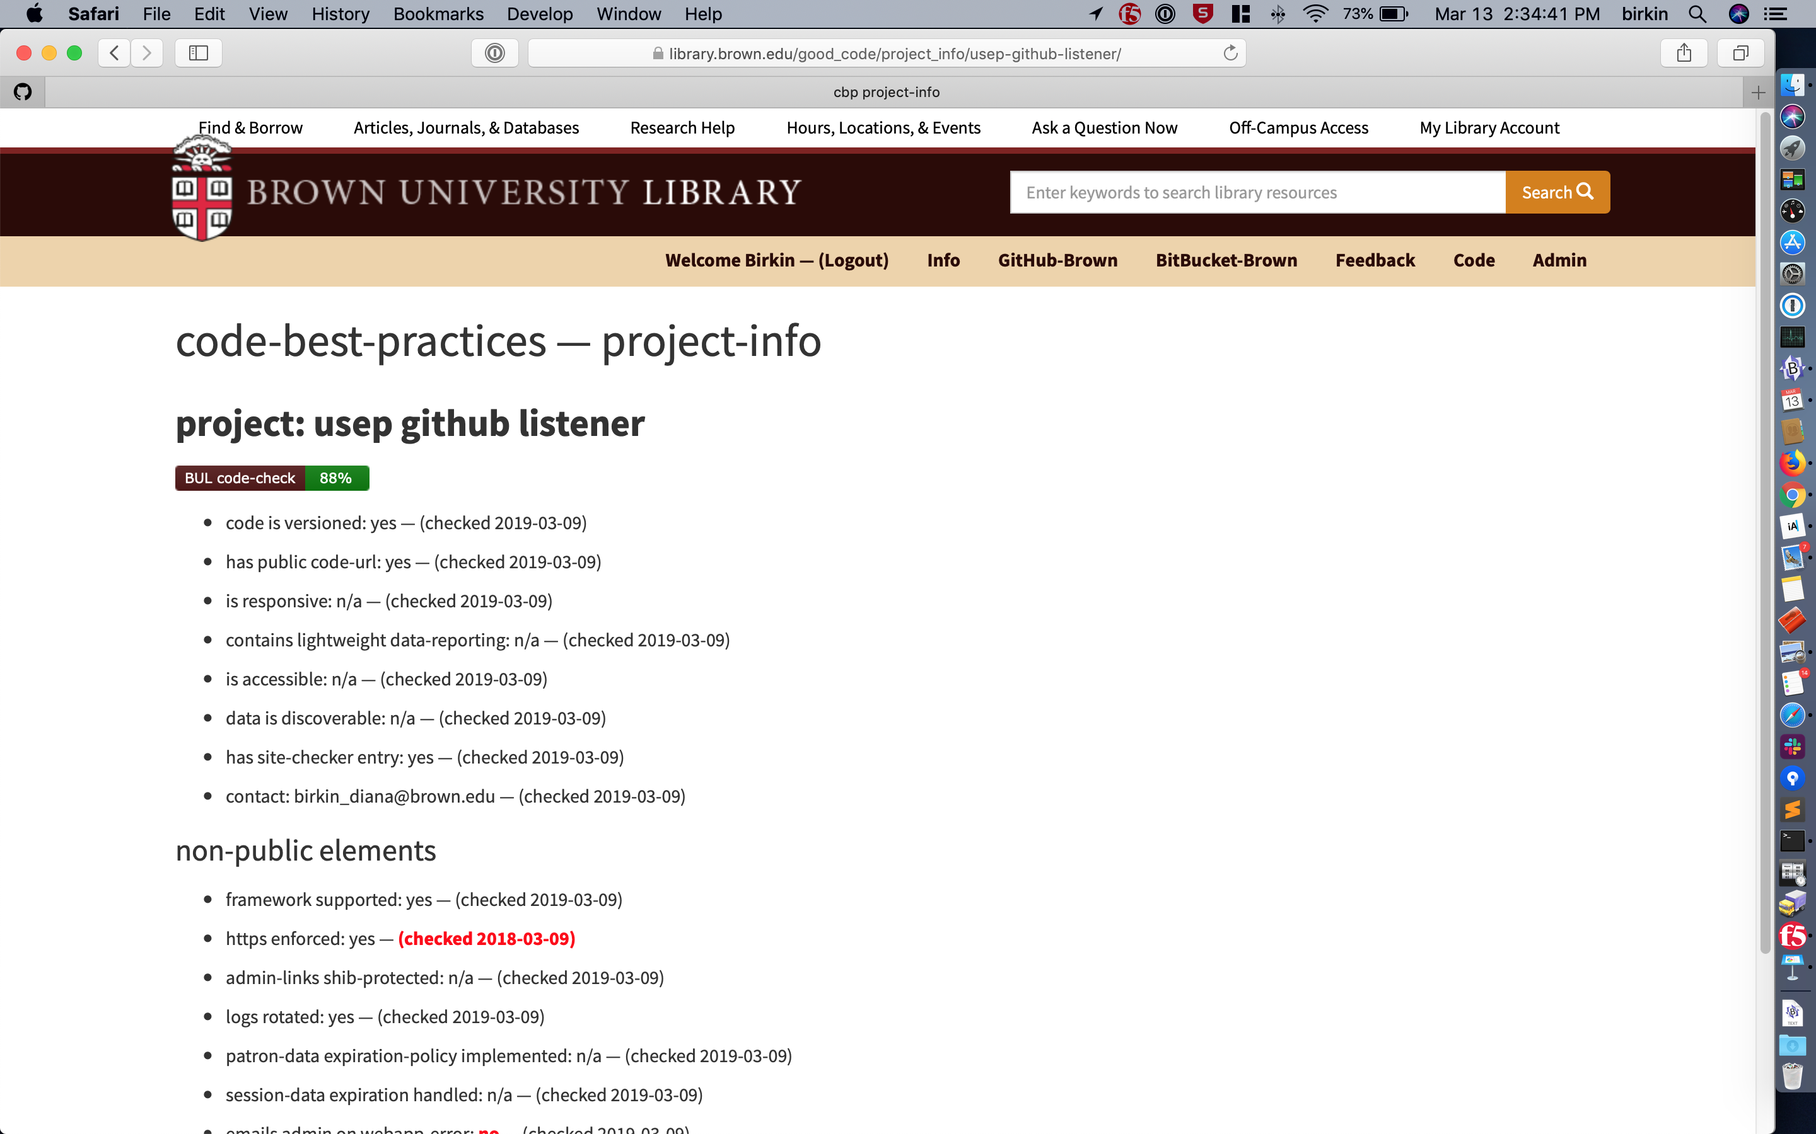
old dates

Slide 15
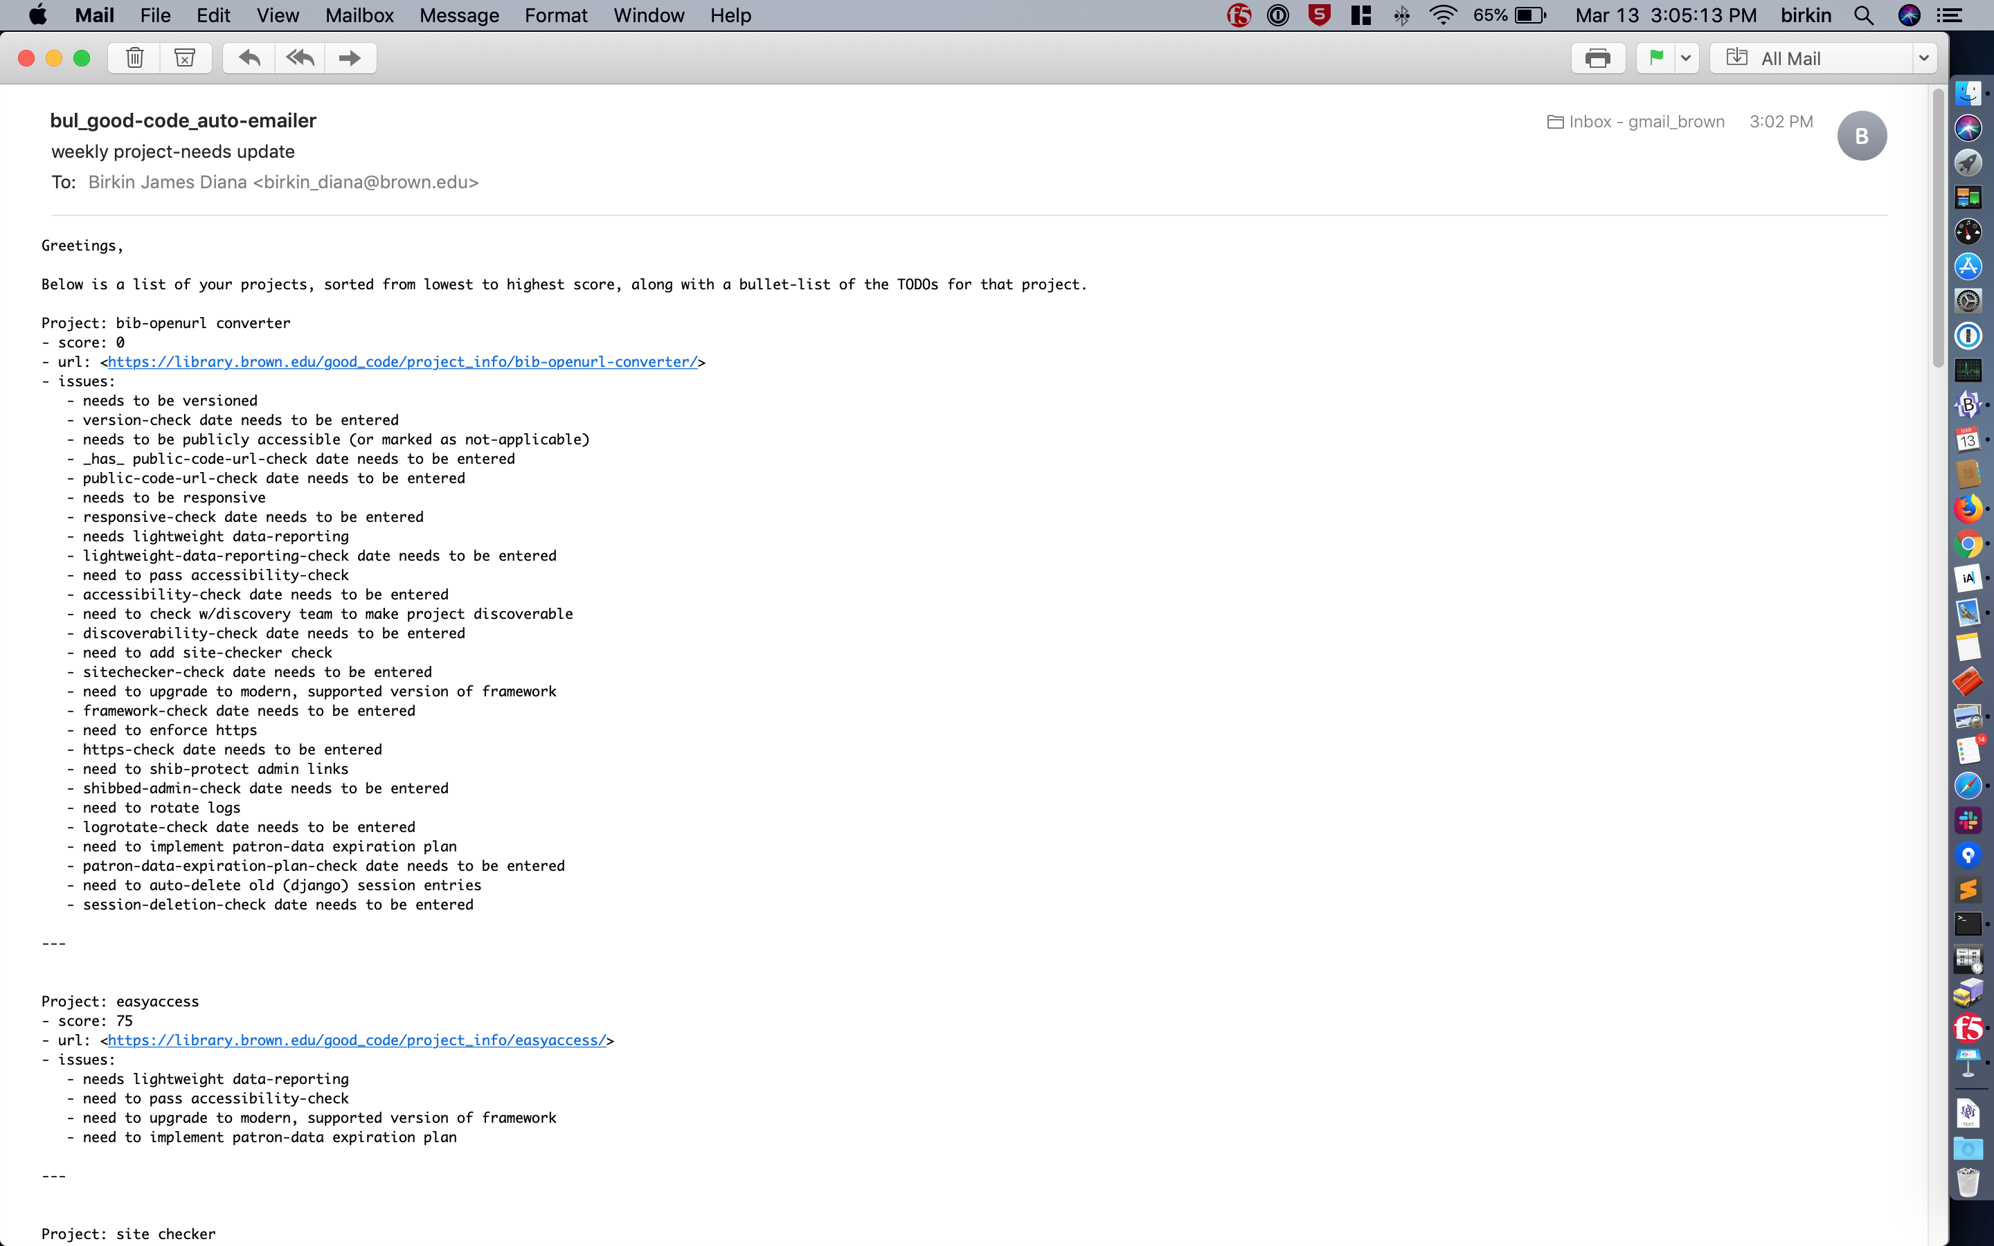
friday email

Slide 16


success ingredients
easy creation/update
code & checklist connected
public-score adds touch of incentive
date-checks & email == not-forgetting
(end)

